Slide 2
Machine health with AWS IoT
IOT315
Mustafa Aldemir
IoT Prototyping Architect
Amazon Web Services

Slide 3
Let’s get to know each other
Name
Company
Role
AWS experience
Internet of Things (IoT) & artificial intelligence (AI) experience

Slide 4







IoT transforms traditional industrial processes
Connectivity
Monitoring
Visualizing
Intelligence
Manufacturing
Network
Transportation
Hardware
Energy
Algorithms
Agriculture

Slide 5
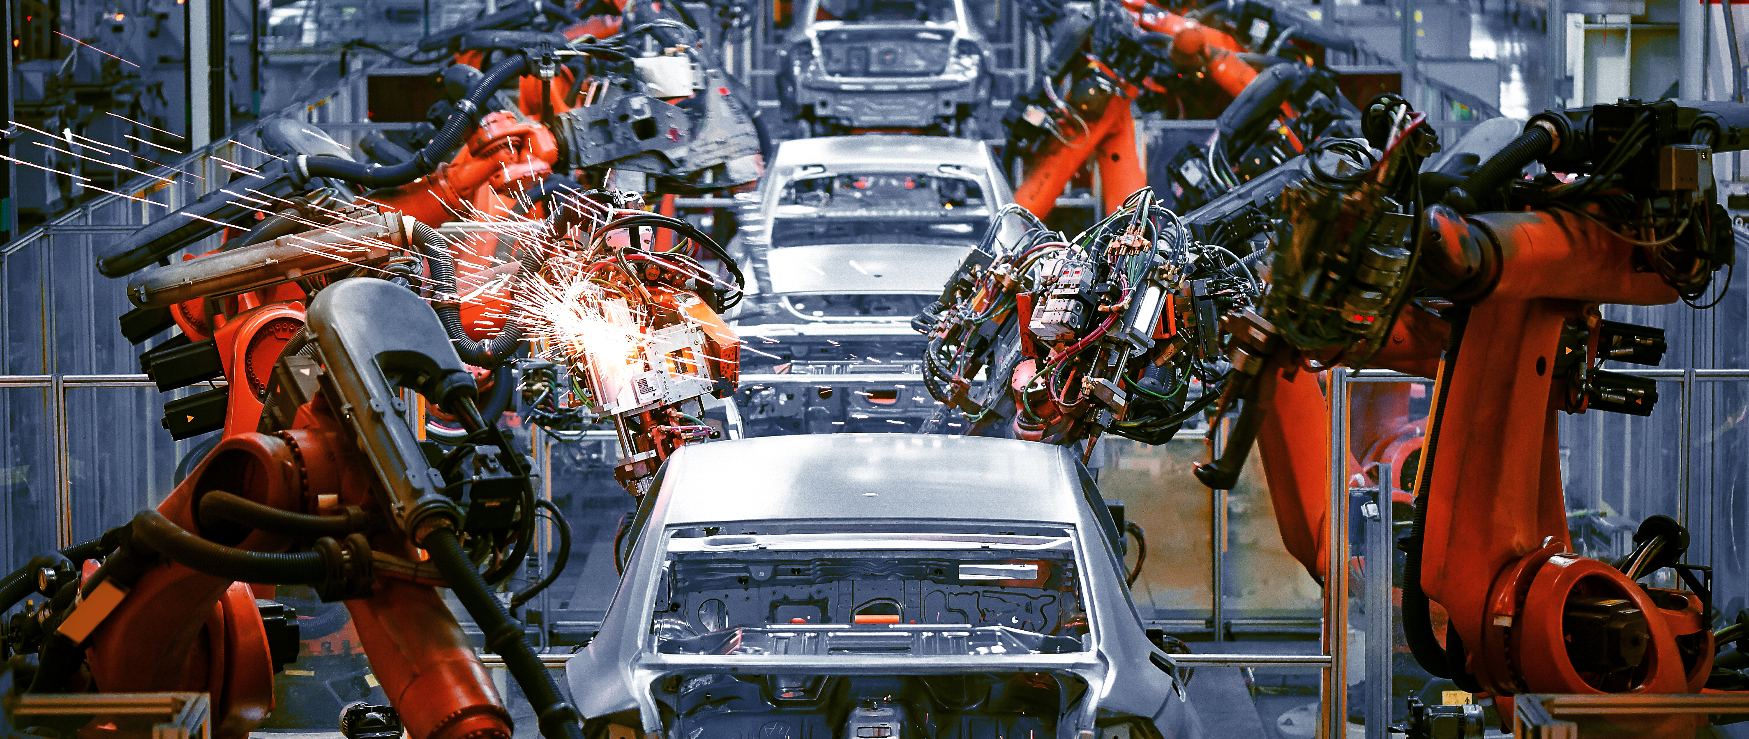
Predictive maintenance
Identify issues before failure
Root-cause analysis
Estimate remaining useful life (RUL)
Get actionable insights

Slide 6
Predictive maintenance
Reduce costs
Avoid unplanned production outages
Plan optimal maintenance work schedule

Slide 7
Scenario

Slide 8
Turbofan degradation prediction
Detect potential equipment failure & send notifications
LSTM (Long Short-term Memory) architecture implemented
Coded in Python with MXNet
Turbofan engine degradation simulation data set taken from NASA
The concept is applicable to other types of machines, data sets and algorithms

Slide 9
Sample data
Cycle | setting1 | … | setting3 | sensor1 | … | sensor21 | Remaining Useful Life (RUL)
1 | 0.07 | … | 1.40 | 518.67 | … | 6.10 | 191
2 | 0.019 | ... | 2.56 | 514.26 | ... | 7.63 | 190
3 | 0.043 | ... | 0.30 | 481.95 | ... | 2.35 | 189
4 | 0.061 | … | 0.00 | 499.41 | … | 10.46 | 188
* https://ti.arc.nasa.gov/tech/dash/groups/pcoe/prognostic-data-repository/

Slide 10
Architecture

Slide 11













Architecture
Failure
Industrial network
DMZ
AWS Cloud
Machine #1
Machine #2
Notebook
AWS IoT Greengrass
OPC-UA
HTTPS
Collect data
Firehose Connector
Data Firehose stream
Raw data
Training data
Amazon SageMaker training job
OPC-UA server
MQTT
No time to collect and label data
Label data
Predict
AWS IoT Core rule
Email/SMS
Trained model
Trained model
EC2 instance of mine
AWS Cloud9 instance of yours

Slide 12
Hands-on implementation

Slide 13
Steps
Go to AWS CloudFormation Console
Deploy template
Go to Cloud9
Start Greengrass
Deploy Lambda functions
Go do Lambda Console
Publish
Create alias
Go to AWS IoT Greengrass Console
Add Lambda functions, ML resource, Firehose connector, subscriptions
Deploy Greengrass group
Go to AWS IoT Console
Create IoT Rule
Subscribe to topics
Go to Amazon SageMaker Notebook
Start new training

Slide 14
Now go to
http://bit.ly/aws-machine-health

Slide 15
Resources

Slide 16
Greengrass
AWS IoT Greengrass seamlessly extends AWS to edge devices.
With AWS IoT Greengrass, connected devices can:
run AWS Lambda functions
execute predictions based on machine learning models
keep device data in sync
communicate with other devices securely
Notes:
AWS IoT Greengrass seamlessly extends AWS to edge devices so they can act locally on the data they generate, while still using the cloud for management, analytics, and durable storage.

Slide 17
Sagemaker
Amazon SageMaker is a fully managed service that covers the entire machine learning workflow:
Collect & prepare training data
Set up & manage environments for training
Deploy model in production
Choose & optimize your ML algorithm
Train & tune model
Scale & manage the production environment
Notes:
Amazon SageMaker provides every developer and data scientist with the ability to build, train, and deploy machine learning models quickly. Amazon SageMaker is a fully-managed service that covers the entire machine learning workflow to label and prepare your data, choose an algorithm, train the model, tune and optimize it for deployment, make predictions, and take action. Your models get to production faster with much less effort and lower cost.

Slide 18
Cloud9
AWS Cloud9 is a cloud-based integrated development environment (IDE) that lets you write, run, and debug your code with just a browser.
Benefits:
Code with just a browser
Code together in real time
Build serverless applications with ease
Direct terminal access to AWS
Start new projects quickly
Notes:
AWS Cloud9 is a cloud-based integrated development environment (IDE) that lets you write, run, and debug your code with just a browser. It includes a code editor, debugger, and terminal. Cloud9 comes prepackaged with essential tools for popular programming languages, including JavaScript, Python, PHP, and more, so you don’t need to install files or configure your development machine to start new projects. Since your Cloud9 IDE is cloud-based, you can work on your projects from your office, home, or anywhere using an internet-connected machine. Cloud9 also provides a seamless experience for developing serverless applications enabling you to easily define resources, debug, and switch between local and remote execution of serverless applications. With Cloud9, you can quickly share your development environment with your team, enabling you to pair program and track each other's inputs in real time.
Benefits
Code with Just a Browser
AWS Cloud9 gives you the flexibility to run your development environment on a managed Amazon EC2 instance or any existing Linux server that supports SSH. This means that you can write, run, and debug applications with just a browser, without needing to install or maintain a local IDE. The Cloud9 code editor and integrated debugger include helpful, time-saving features such as code hinting, code completion, and step-through debugging. The Cloud9 terminal provides a browser-based shell experience enabling you to install additional software, do a git push, or enter commands.
Code Together in Real Time
AWS Cloud9 makes collaborating on code easy. You can share your development environment with your team in just a few clicks and pair program together. While collaborating, your team members can see each other type in real time, and instantly chat with one another from within the IDE.
Build Serverless Applications with Ease
AWS Cloud9 makes it easy to write, run, and debug serverless applications. It preconfigures the development environment with all the SDKs, libraries, and plug-ins needed for serverless development. Cloud9 also provides an environment for locally testing and debugging AWS Lambda functions. This allows you to iterate on your code directly, saving you time and improving the quality of your code.
Direct Terminal Access to AWS
AWS Cloud9 comes with a terminal that includes sudo privileges to the managed Amazon EC2 instance that is hosting your development environment and a preauthenticated AWS Command Line Interface. This makes it easy for you to quickly run commands and directly access AWS services.
Start New Projects Quickly
AWS Cloud9 makes it easy for you to start new projects. Cloud9’s development environment comes prepackaged with tooling for over 40 programming languages, including Node.js, JavaScript, Python, PHP, Ruby, Go, and C++. This enables you to start writing code for popular application stacks within minutes by eliminating the need to install or configure files, SDKs, and plug-ins for your development machine. Because Cloud9 is cloud-based, you can easily maintain multiple development environments to isolate your project’s resources.

Slide 19
Kinesis Firehose
Amazon Kinesis Data Firehose is the easiest way to reliably load streaming data into data lakes, data stores and analytics tools.
Fully managed service that automatically scales to match the throughput of your data
It can:
Capture,
Transform,
Batch,
Encrypt,
Load data into various destinations

Slide 20
S3
Amazon Simple Storage Service is an object storage service that offers
scalability,
data availability,
security,
and performance

Slide 21
OPC-UA
OPC Unified Architecture (OPC UA) is a machine to machine communication protocol for industrial automation.
Distinguishing characteristics:
Open (GPL 2.0 license)
Cross-platform
Service-oriented architecture (SOA)
Inherent complexity
Robust security
Integral information model

Slide 22
LSTM
Long short-term memory (LSTM) is an artificial recurrent neural network (RNN) architecture used in the field of deep learning.
It can not only process single data points (such as images), but also entire sequences of data (such as speech or video).
LSTM networks are well-suited to time-series data, since there can be lags of unknown duration between important events in a time series.

Slide 23
Questions?

Slide 24
Takeaways
IoT and ML are transforming industrial operations
Predictive Maintenance is used for reducing failure costs
Predictive Maintenance can be applied for many use cases
AWS provides tools for developing and bringing intelligence to the edge

Slide 25
Mustafa Aldemir
aldemim@amazon.lu

Slide 27
Appendix

Slide 28
Links
http://bit.ly/aws-machine-health
http://bit.ly/aws-iiot
http://bit.ly/greengrass-ml-workshop
http://bit.ly/aws-predictive-maintenance

